Slide 1

Machine learning
Youssef Mohamed Moustafa:22101287
Aladdin Ibrahim said:22101463
Rana HossamEldin Mohamed:22101478

Slide 2
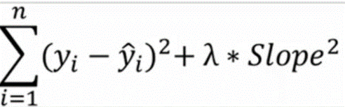
Ridge Modules(bonus):
It takes the function of the Linear regression and add to it a value that called penalty.
It gives the average between the overfitting and underfitting data to make us get a low variance and low bias.
The strength of the regularization is controlled by the alpha parameter. A higher alpha means stronger regularization, resulting in smaller coefficient estimates. The optimal value of alpha can be selected using techniques like cross-validation.

Slide 3
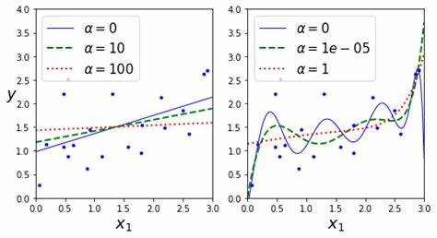
It can stabilize the regression estimates, especially when the number of predictors is larger than the number of observations.
It provides a simple efficient way to introduce regularization into linear regression models.
From it disadvantage:
It assumes that all predictors are equally important, which might not always be the case.
It doesn't perform variable selection, meaning it won't set coefficients to exactly zero.

Slide 4
